Slide 1
Best location to start a new veterinary clinic in California
Juhwan Kim

Slide 2
Background
starting a private veterinary practice is risky, and needs to consider many factors
location, real estate, population, living of cost, and competition between the clinics.
it is advantageous to accurately predict which neighborhood is the good candidate to start the business.

Slide 3
Data cleaning and preparation
California data from the first dataset containing coordinates, zip code, city name, and population of the US.
used for searching veterinary clinics in California.
I merged collected data, and which contains coordinates, zip code, city name, population, house value, income. House value and income are described as thousand dollars in the dataset.
To get the name of veterinary clinics in California, I used Foursquare API.

Slide 4
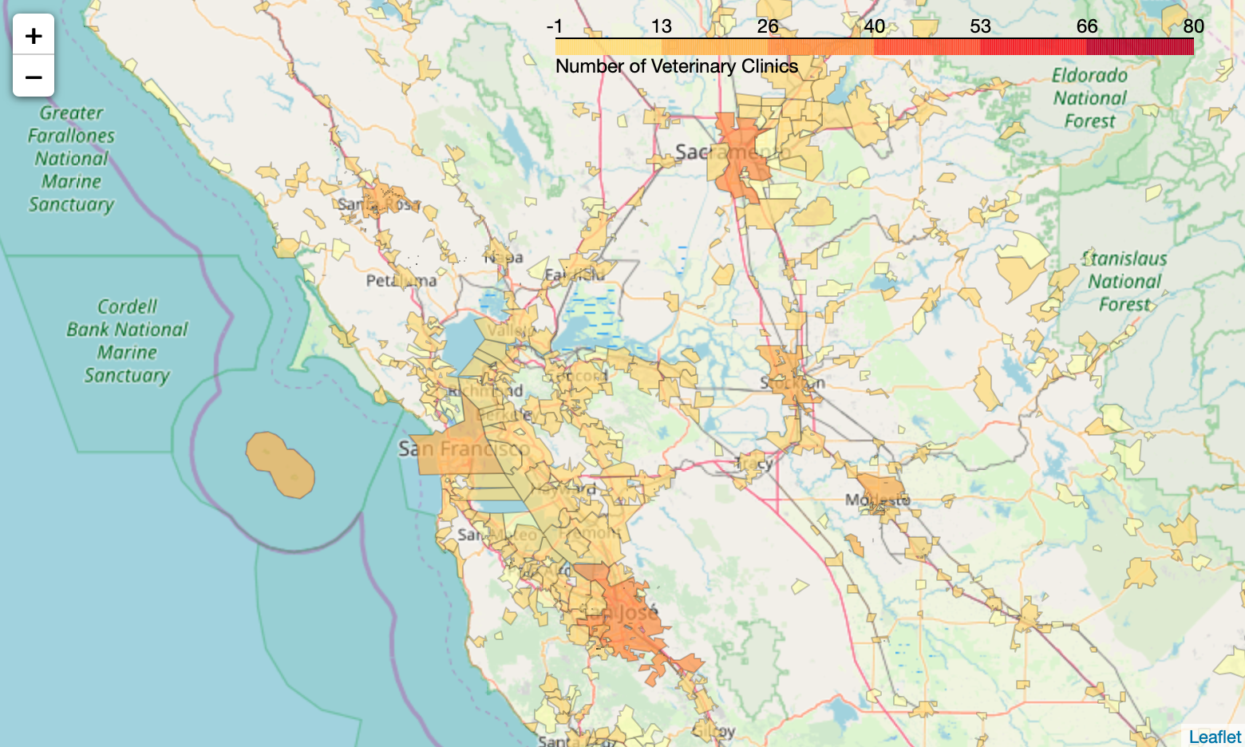
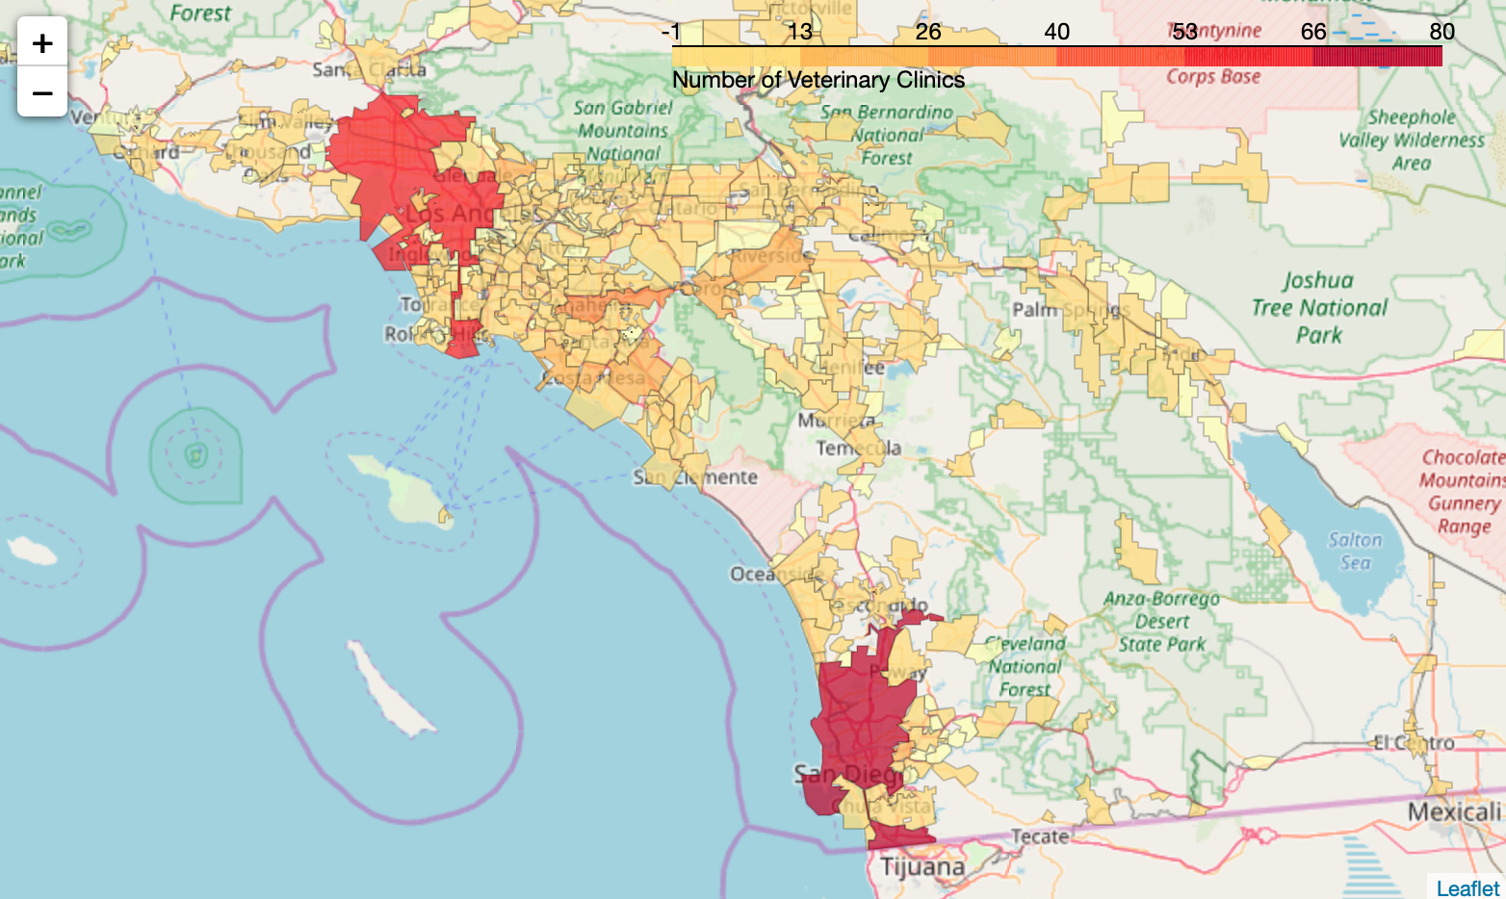
Distribution of veterinary clinics in California
Northern California
Southern California
A
B

Slide 5
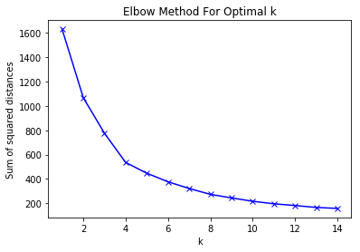
Elbow method to find the optimal k value for KMeans clustering

Slide 6
California Neighborhoods clustering
A
B

Slide 7
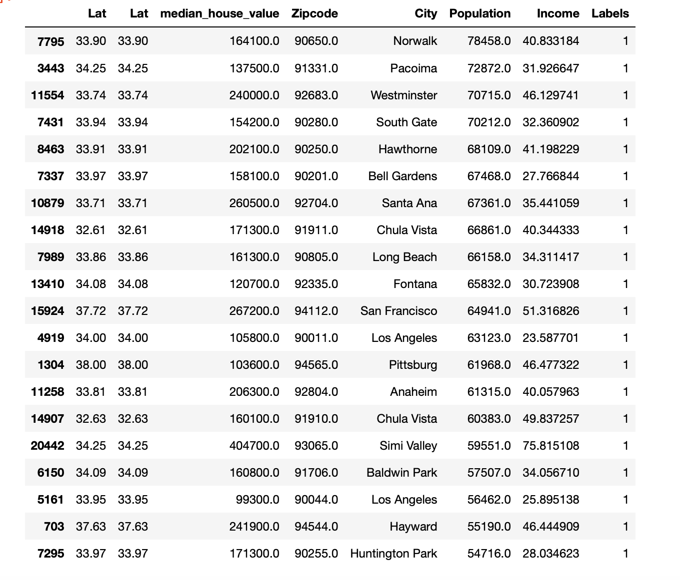
Top 20 neighborhoods in cluster 1.

Slide 8
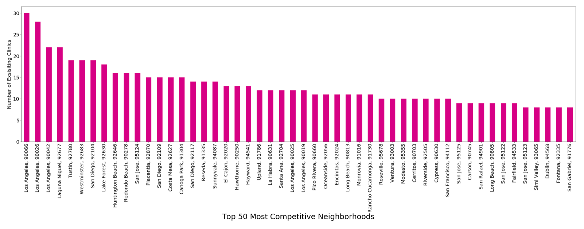
Top 50 neighborhoods in cluster 1 having the most veterinary clinics

Slide 9
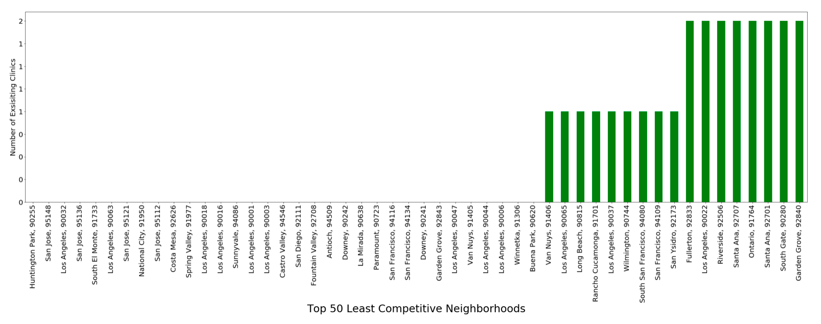
Top 50 neighborhoods in cluster 1 having the least veterinary clinics

Slide 10
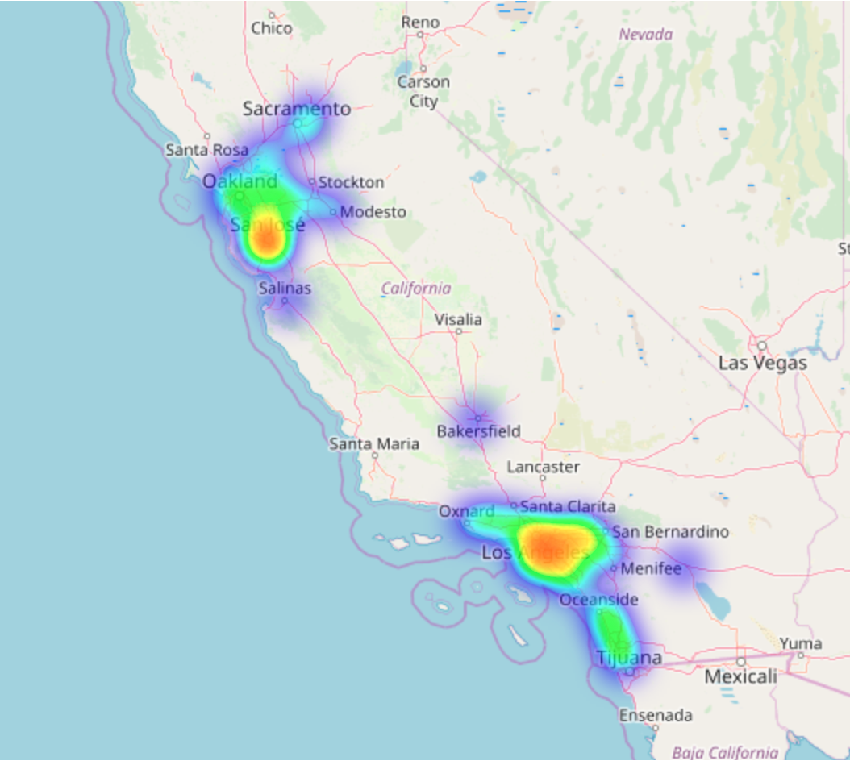
Distribution of neighborhoods in cluster 1 in California

Slide 11
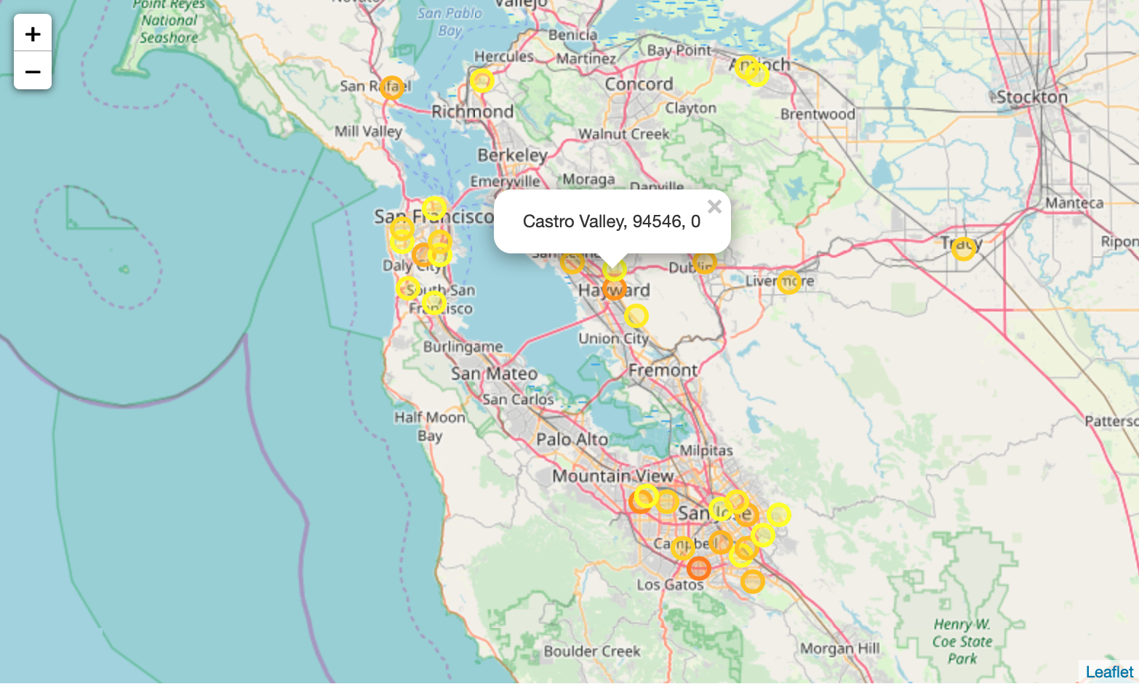
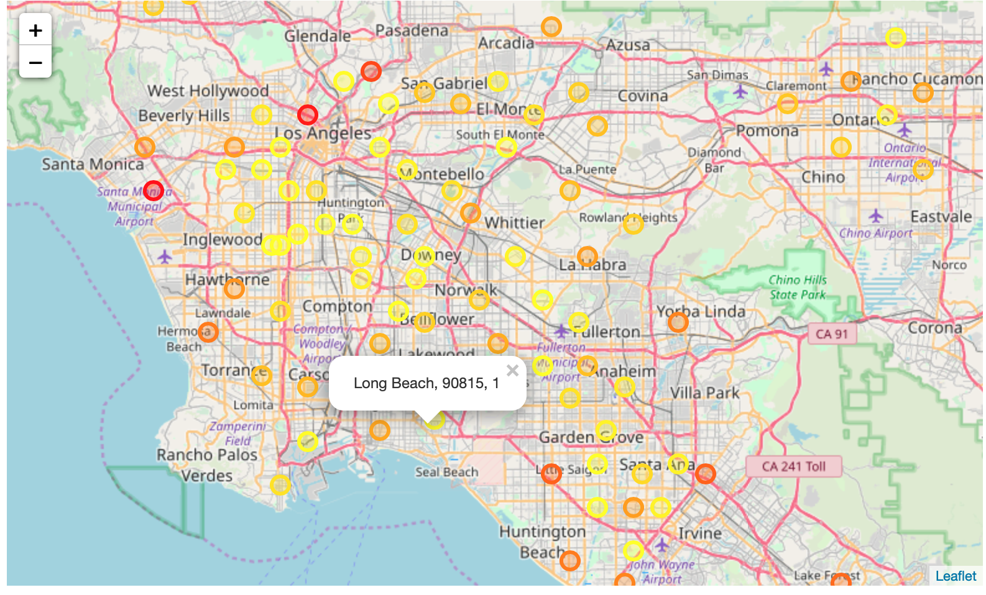
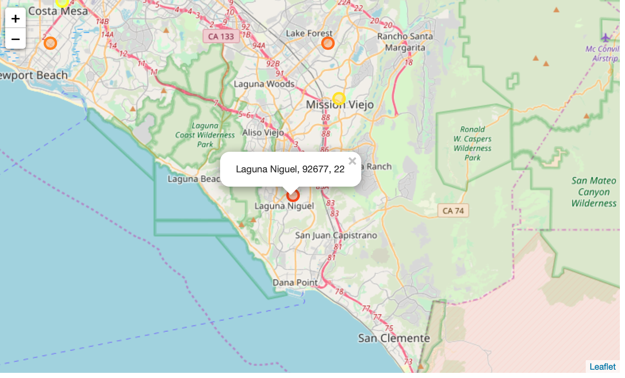
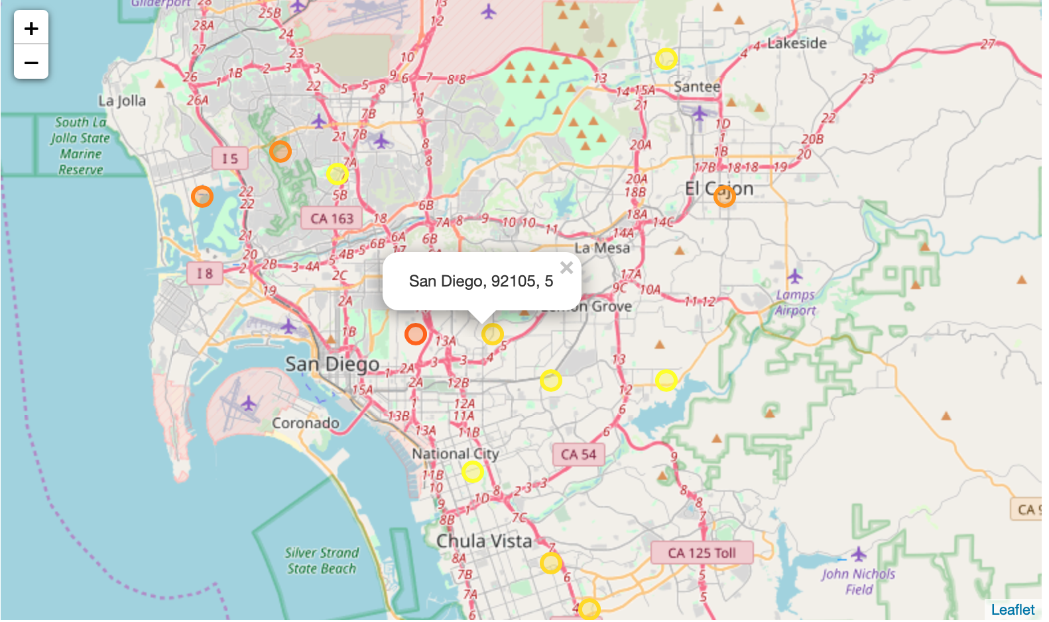
Best neighborhoods for starting veterinary clinic in California

Slide 12
Discussion
I used the demographic data to predict the best candidates.
It can be overly simplified.
In real world, there are many factors
public transportation, traffic in neighborhood, parking
In the future study, it would be interesting to consider the proximity to the transportation station to find the best location in the big cities like Los Angeles, San Diego, and San Francisco.
It would be necessary to use diverse demographic data for targeting specific customers
race, age of households and estimated pet numbers in each neighborhood

Slide 13
Conclustion
This project shows potential best locations to start the new business in California based on a combination of location-based API and demographic data.

Slide 14
References
[1] https://www.stevedalepetworld.com/blog/world-pet-population-data-mixed-bag/
[2] https://www.avma.org/KB/Resources/Statistics/Pages/Market-research-statistics-US-pet-ownership.aspx
[3] https://www.ftc.gov/sites/default/files/documents/public_events/pet-medications-workshop/daspros.pdf
[4]https://www.aavmc.org/assets/site_18/files/annual%20reports/v3_econ_2016_report3_mketvet_061416.pdf
[5] https://www.ibisworld.com/industry-trends/market-research-reports/professional-scientific-technical-services/professional-scientific-technical-services/veterinary-services.html
[6] http://federalgovernmentzipcodes.us
[7] https://www.kaggle.com/camnugent/california-housing-prices
[8] https://data.world/jonloyens/irs-income-by-zip-code
[9] http://boundaries.latimes.com/sets/
[10] https://foursquare.com

